Slide 1
Image processing and steganography
BY GROUP 8 :-
Ayush Dey (2051106)
Pubayan Sanyal (2051141)
Bijit Kumar Sarkar (2051115)
Md. Shahid Alam (2051133)
Bikram Saha (2051116)
(College roll nos mentioned)

Slide 2
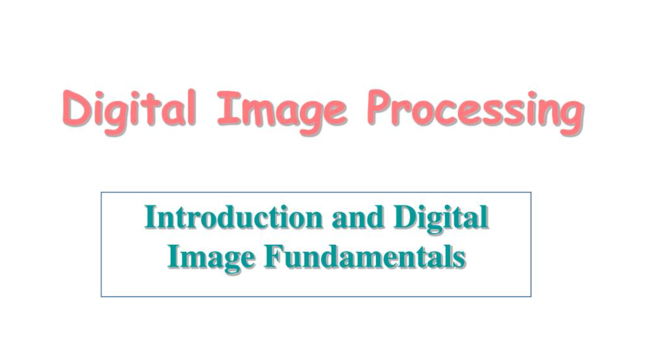

Slide 3
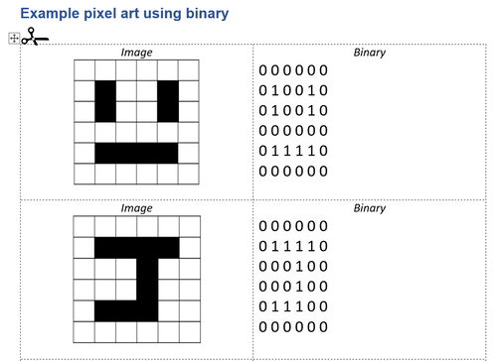
Digital Image Life Cycle
Image Capture : Image sensor usage for conversion of light and colour data into digital format
Sampling : Digital data segmentation into 2D array pixel and pixel channels
Quantization : Binary code allotment for every pixel (gray-scale image – 1 byte pixel colour image – 3 byte pixel value)

Slide 4
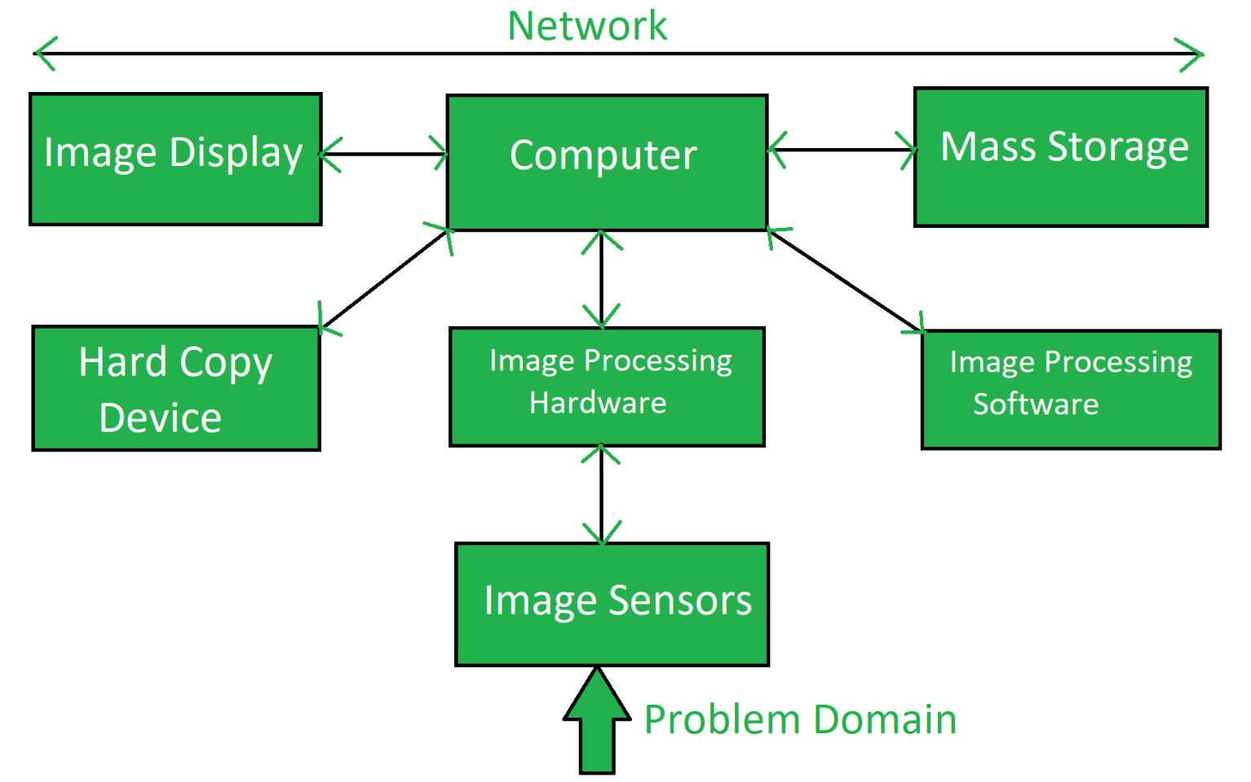
Digital Image Life Cycle
Compression : Reduction of file size for ease of storage and transmission
Storage : Digital image is stored in various file formats , for example – JPEG , PNG ,TIFF
Image display : Binary data conversion back into pictorial form for end user display

Slide 5
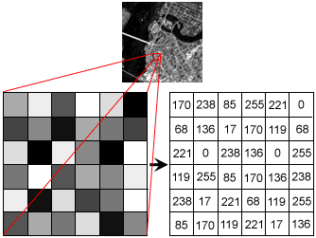
Image processing: Grayscale
Single – channel pixel : For grayscale images , 8 – bit color depth is required
Some basic terminologies
Pixel: basic unit of programmable color on a computer display or in a computer image
Sampling rate: number of samples per unit area taken from a continuous signal to make a discrete or digital signal
Resolution: It refers to the number of pixels that make up an image

Slide 6
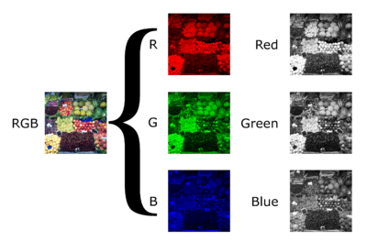
Image processing: Color
Three – channel pixel : For colored images , 24 – bit color depth is used
Some basic terminologies
Color/Bit depth: Size of each pixel (in bits)
Quantization level: Refers to the number of discrete levels that are used to represent a continuous signal in digital form. For example, in an 8-bit color depth image, there are 256 possible levels of brightness or color that can be assigned to each pixel.

Slide 7
Image manipulation
Some common manipulation techniques while editing an image :-
Applying transformation : For example , if brightness of image needs to be increased , the manipulation software may multiply every pixel by a scaling factor
Interpolation : While resizing images , interpolation is used to estimate the color values of new pixels
Working with image layers : Many editing programs use a layered approach to allow the user to edit each layer independently.

Slide 8
Image Recognition
Steps involved in image recognition:
Preprocessing: Preparation for analysis by resizing, normalizing, and converting it into a digital format that can be processed by the computer.
Feature extraction: Computer identifies features in the image, such as edges, shapes, and colors, and extracts them as numerical values.
Feature representation: The numerical values are organized into a mathematical representation for analysis.
Classification: Computer compares the feature representation of the image to a pre-defined set of categories or labels and determines which category the image belongs to.
Post-processing: The classification result is refined and adjusted to improve accuracy and reduce errors.

Slide 9

Steganography
Definition : Hiding of secret data inside seemingly harmless file (cover file) to avoid third – party detection
Basic procedure : Embedded at sender’s end and extracted at final receiver destination
Advantage and coherent usage with cryptography : Combination of characteristics of both to enhance encryption and non-detection

Slide 10
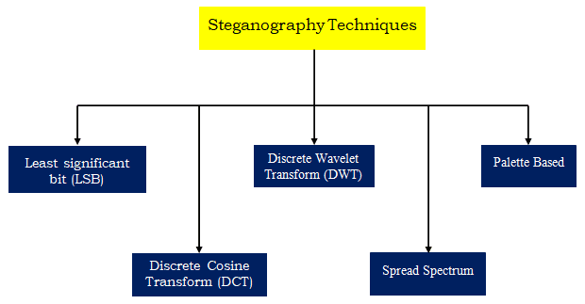
Techniques to implement steganography
Least Significant Bit Substitution(LSB substitution) : LSB manipulation in pixel value
Masking and Filtering : Watermark and similar marking manipulation
Transformations and algorithms : Discrete Cosine Transform co-efficient relation change technique

Slide 11
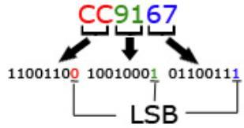
Least Significant Bit (LSB) Substitution
Basic idea : To change the least significant bits in each pixel channel present
Why LSB only : Manipulating LSB will least affect the original picture ( reducing the chance of the secret data being detected )
Disadvantage : Compression or type conversion of the image file may corrupt LSB secret data bit value

Slide 12
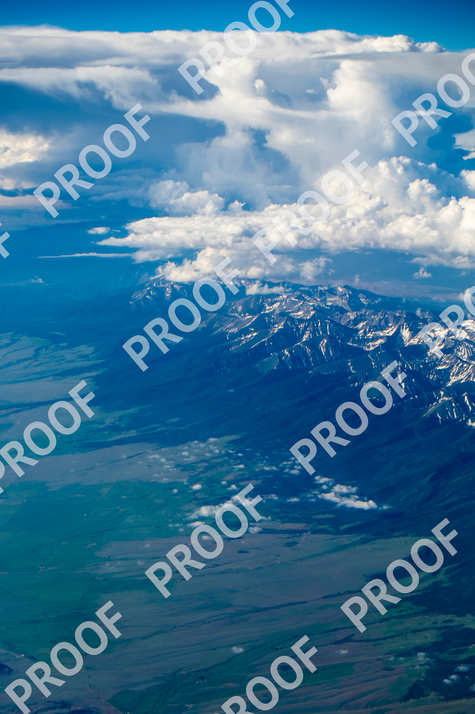
Masking and Filtering
Basic idea : To manipulate the information provided by an image watermark or any mark on the image
Key point : Makes the secret data more integral to the image file in addition to concealing it
Original image retained : No change in original image pixel binary bits ( further reducing the chance to detect )
Does compression or file type conversion affect the hidden data : NO

Slide 13
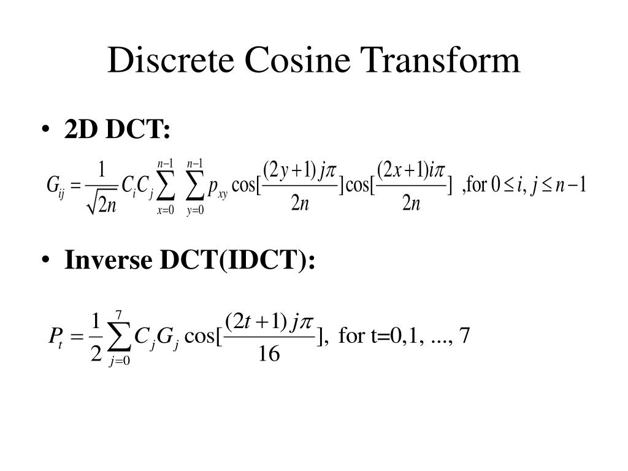
Algorithms and Transformation Techniques
Transformation ( for example – compression in JPEG ) – Mathematical functions to change pixel values , lowering the threshold value of every channel
Discrete Cosine Transform (DCT) –Expression relating the pixel values contain cosine function ; the waveform of the function can be represented as a sum of weighted cosines
Data Hiding – Data is hidden by manipulating least significant coefficients used in DCT transform

Slide 14
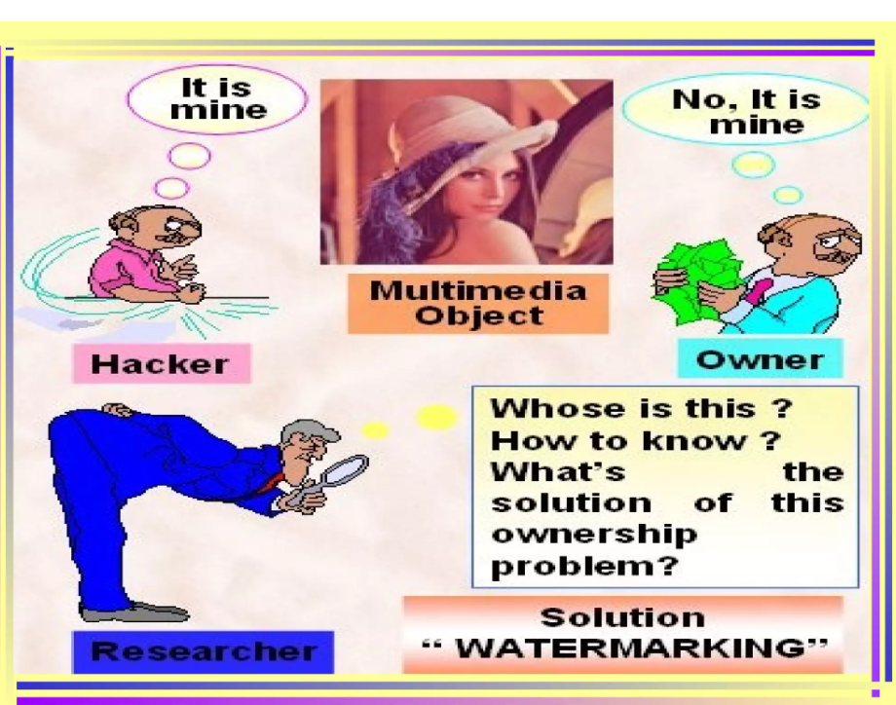
Whose Ownership

Slide 15

Watermarking
Digital Watermarking : Methods and technologies that hide information by marking an image
Watermarking : Insertion of imperceptible and inseparable data into the marking , making it an integral part of the image file

Slide 16
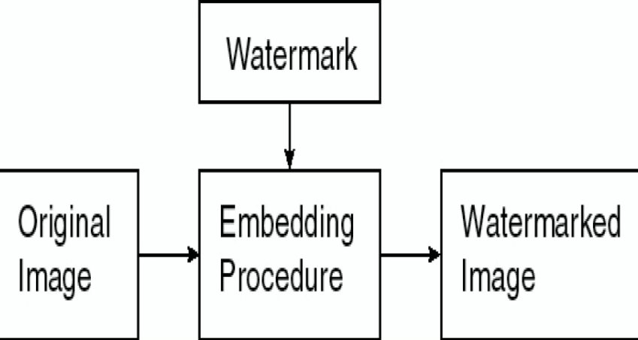
General Watermarking Procedure

Slide 17
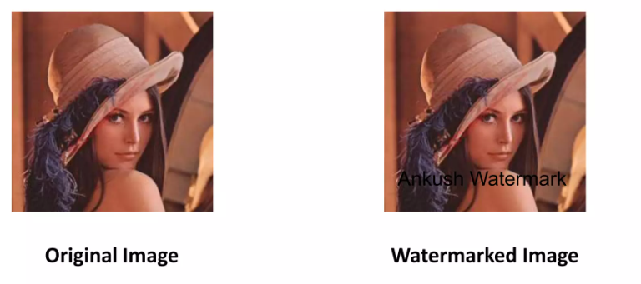
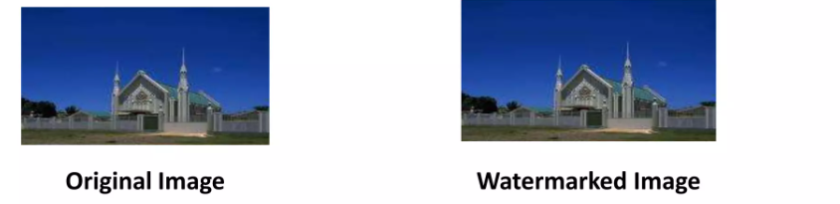
Types of Watermarking
Visible Watermarking : Translucent overlaid into an image ; visible to the viewer
Invisible Watermarking : Embedding done in such a way that pixel value changes are not perceptually noticed

Slide 18
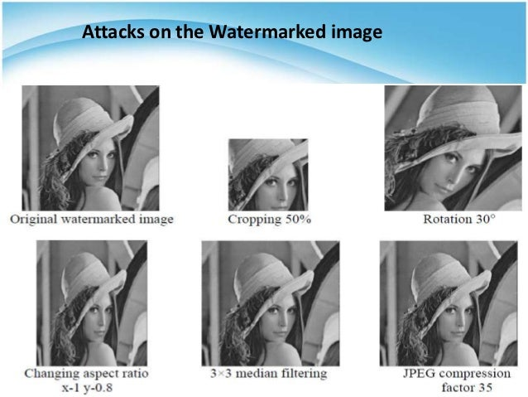
Attacks on Watermarking
Robustness : Intent to remove watermark
Presentation : Watermark content manipulation to bypass detection
Counterfeiting attacks : Fake image generation by rendering the original image

Slide 19

Applications of Watermarking
Authentication : Validation check
Ownership : Ownership rights

Slide 20
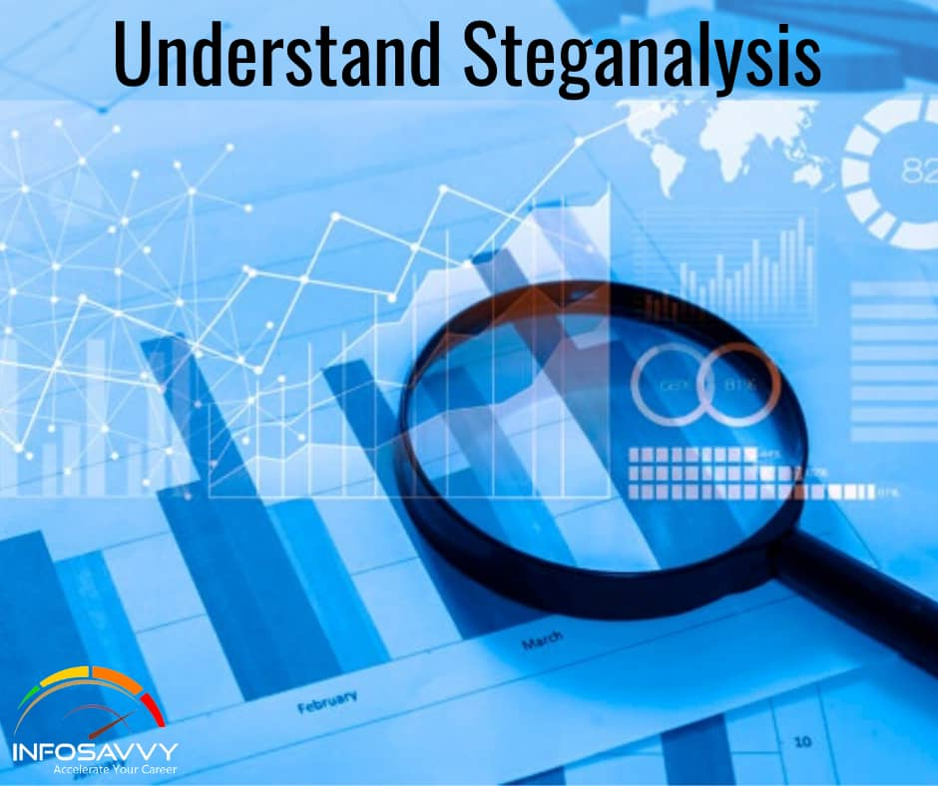
Steganalysis
Definition : Steganalysis is the process of detecting the presence of hidden information within an image, video, audio or other digital media
Key point : Steganalysis is an important tool for detecting malicious or illegal activities such as transmission of sensitive information, terrorism and cybercrime

Slide 21
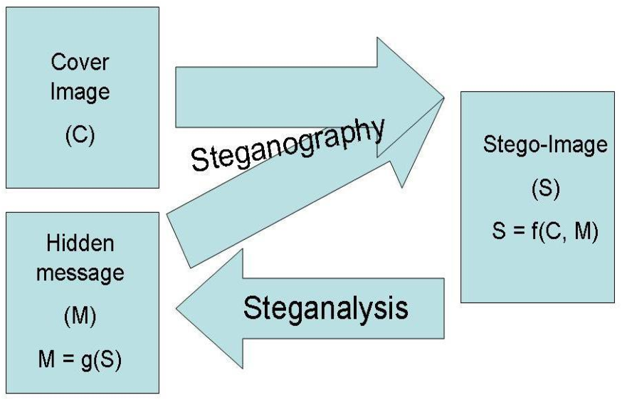
Steganalysis Techniques
Passive Steganalysis : Analyzing media without modifying or altering the file
Key Point : Usage of statistical properties to identify anomalies and inconsistencies

Slide 22

Steganalysis Techniques
Active Steganalysis : Involves manipulating the media file
Other Methods : Visual Inspection ; Statistical Analysis ; Machine Learning

Slide 23
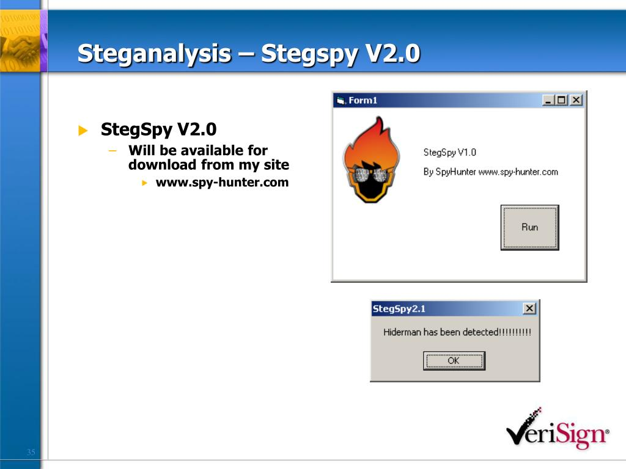
Steganalysis Tools
StegDetect
Outguess
Gargoyle Investigator
S-tool
OpenPuff
QuickStego
Key Point : We need to keep in mind that all those tools mentioned above for steganalysis are not foolproof, they may not detect all the hidden informations

Slide 24

Can We Store Malicious Data Using
Steganography
Yes : Can be used even in cyber-crime
Ways to store : Image steganography ; Audio steganography ; Text steganography

Slide 25
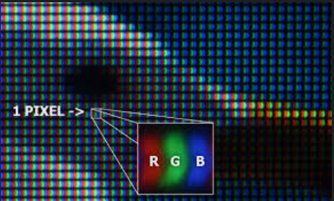
Revisiting LSB Substitution
LSB Substitution: change the least significant bits in pixel channel present to carry message.
Image -> Pixels -> RGB values
Use the units place of G-value as part of the secret message.
(127, 23, 69)

Slide 26
Our LSB Substitution Algo
Our image [original_image]
Our text -> image (of size same as original_image) with the text [text_image]
Map each pixel of text_image to original_image
For all pixels repeat:
If particular pixel in text_image is white [no text] we change the units digit of G-value of corresponding pixel in original_image to NOT 7.
If particular pixel in text_image is black [text] we change the units digit of G-value of corresponding pixel in original_image to 7.
Finally original_image -> image_with_secrets
Decoding? -> check the LSB of G-values for each pixel -> text_image

Slide 27
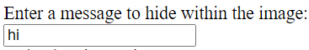


text_image
original_image
Image_with_secrets
R G B
+
black
=
R G B
(xxx, xxx, xxx)
(xxx, xx7, xxx)

Slide 28
DEMO

Slide 29
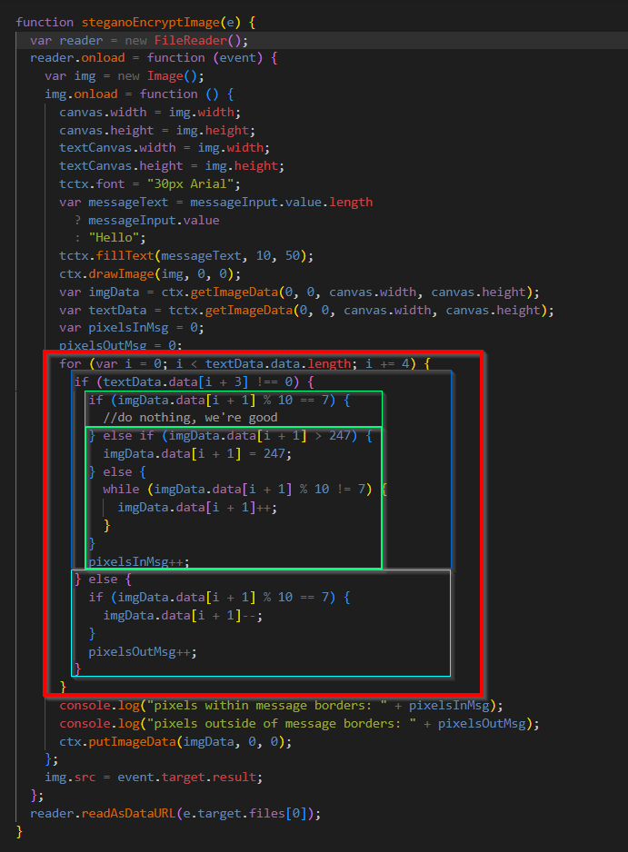
Encryption Code
If (particular pixel in text_image is black){
if(G-value of particular pixel in original_image == 7){
doNothing;
}
if(unitDigit ofG-value of particular pixel in original_image != 7){
makeItEndWithA7;
}
moveToNextPixel;
}else if (particular pixel in text_image is white){
if(G-value of particular pixel in original_image == 7){
makeItSomethingElse;
}
moveToNextPixel;
}

Slide 30
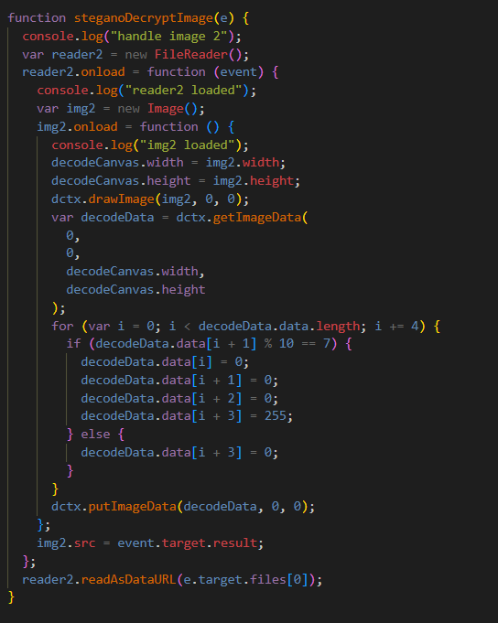
Decryption Code
Basically reversing the algorithm to get back the data

Slide 31
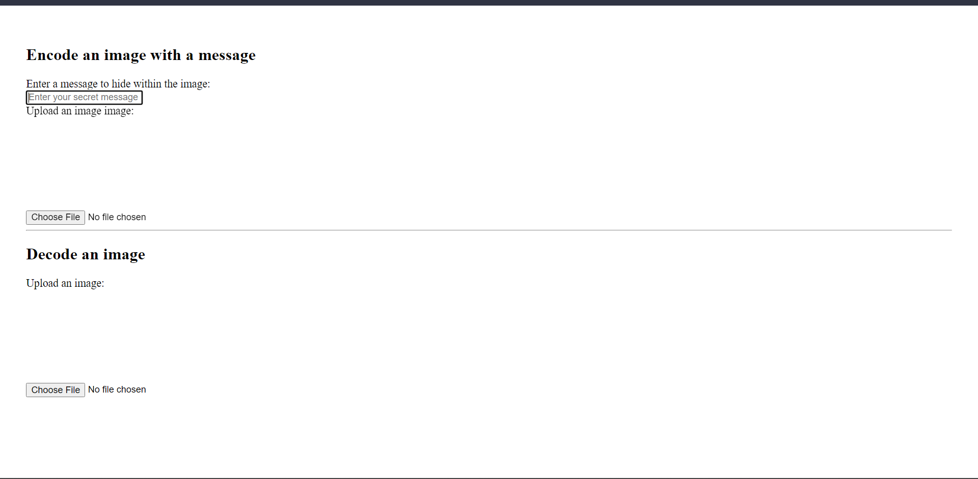
Step 1: WebPage

Slide 32
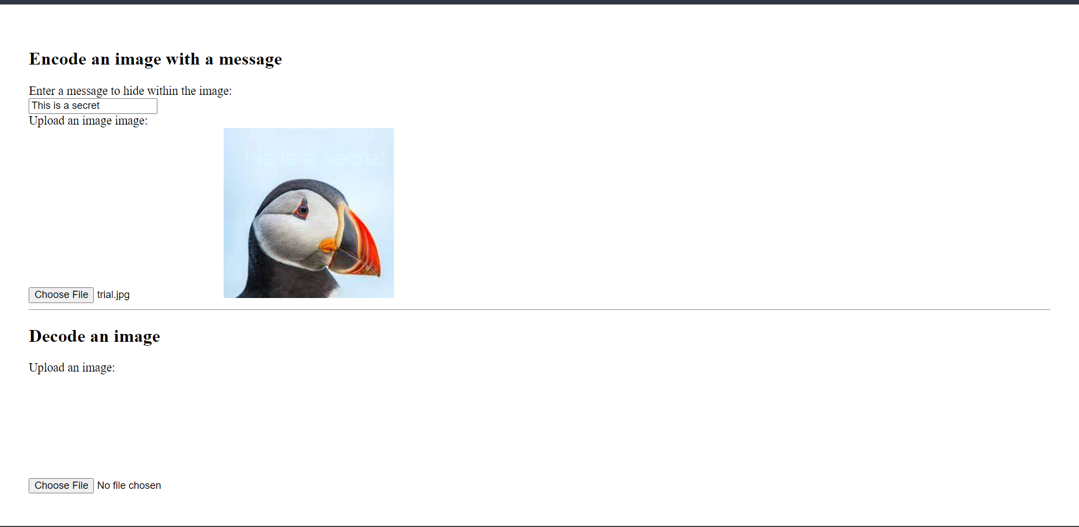
Step 2: storing secret data
Secret message input
Manipulated Image Generated
(can be downloaded)
Original image chosen

Slide 33
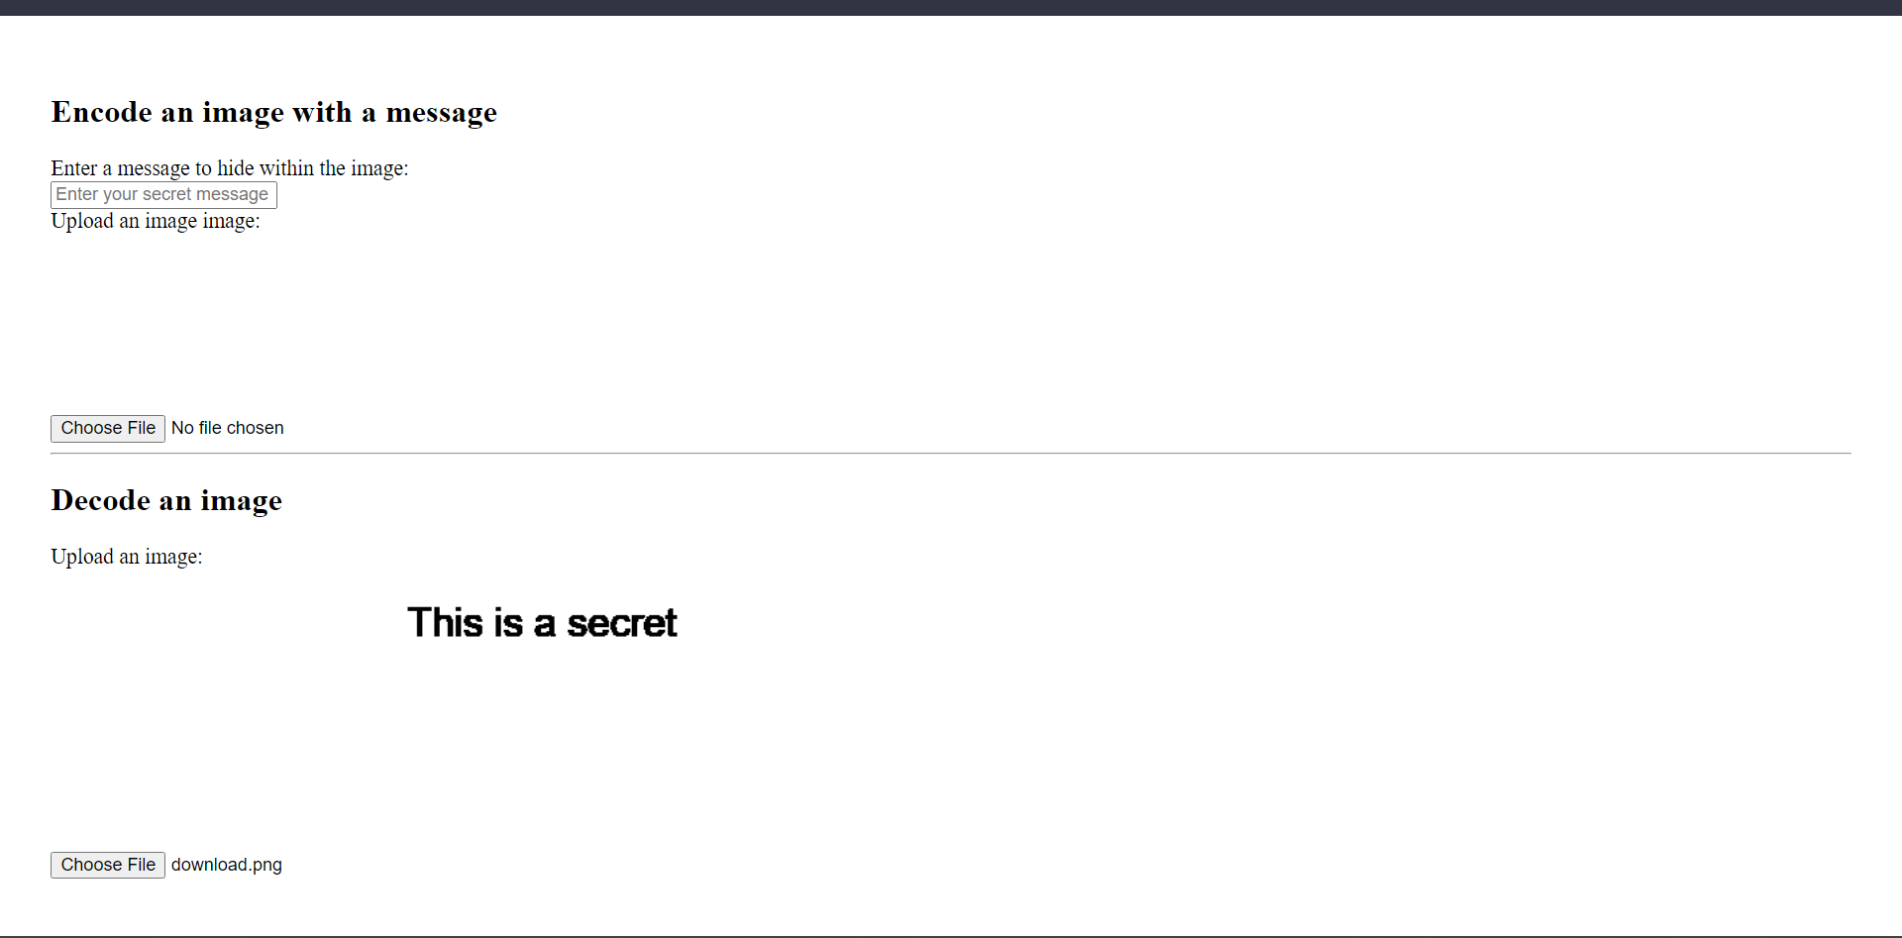
Step 3: Retrieving secret Data
Secret Retrieved
Manipulated image chosen

Slide 34
References
http://io.acad.athabascau.ca/~grizzlie/Comp607/techniques.htm
Watermarking (athabascau.ca)
https://www.geeksforgeeks.org/digital-image-processing-basics
https://en.wikipedia.org/wiki/Steganography

